Slide 1

Relational Databases
Normalization and Functional dependency

Slide 2
Normalization
  Normalization is a technique for producing a set of suitable relations that support the data requirements of an enterprise.

Slide 3
Purpose of Normalization
Characteristics of a suitable set of relations include:
  The minimal number of attributes necessary to support the data requirements of the enterprise;
  Attributes with a close logical relationship are found in the same relation;

Slide 4
Purpose of Normalization
  The benefits of using a database that has a suitable set of relations is that the database will be:
  Easier for the user to access and maintain the data;
  Take up minimal storage space on the computer.

Slide 5
Data Redundancy and Update Anomalies
  Major aim of relational database design is to group attributes into relations to minimize data redundancy.

Slide 6
Data Redundancy and Update Anomalies
  Problems associated with data redundancy are illustrated by comparing the Staff and Branch relations with the Staff Branch relation.

Slide 7


Data Redundancy and Update Anomalies

Slide 8
Data Redundancy and Update Anomalies
  Staff Branch relation has redundant data; the details of a branch are repeated for every member of staff.
  In contrast, the branch information appears only once for each branch in the Branch relation and only the branch number (branch No) is repeated in the Staff relation, to represent where each member of staff is located.

Slide 9
Data Redundancy and Update Anomalies
  Relations that contain redundant information may potentially suffer from update anomalies.
  Types of update anomalies include
  Insertion
  Deletion
  Modification

Slide 10
Normalization
It is a technique to remove or reduce redundancy from a table .
It is very important topic in DBMS
There are basically two types of duplicacy in tables in database
  Row level
  Column level

Slide 11
Normalization
Row level duplicacy –
  Relation (Student )
Sid | Name | Age
1 | sara | 20
2 | ali | 30
1 | Sara | 20

Slide 12
Normalization –column level duplicacy
Sid | Sname | cid | Cname | Fid | Fname | Salary
1 | Ali | C1 | DB | F1 | Maryam | 30000
2 | Sara | C2 | DB | F2 | Ahad | 20000
3 | sana | C1 | DB | F1 | Maryam | 30000
4 | Zohaib | C1 | DB | F1 | Maryam | 30000
5 | Anum | C1 | DB | F1 | Bushra | 60000
6 | Irha | C1 | DB | F1 | Saira | 50000
Notes:
Remove the data of the student whose roll no is 1
Delete from student
Where SID =1

Slide 13
Problems
So basically, problems comes in three types
  Insertion anomaly
  Deletion anomaly
  Updation anomaly
So how these problems would be resolved by normalization( we will discuss later)
Simple solution
  To divide the table in multiple tables
Notes:
Update student
Set sname =sara ali
Where sid=2
If I want to change the salary of faculty f1 from 30k -60k

Slide 14
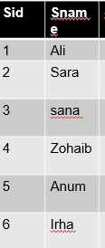
Solution
CID | Cname
c1 | Db
c2 | DB1
FID | F-name | Salary
F1 | maryam | 30000
F2 | Ahad | 20000
F3 | Bushra | 50000
F4 | Saira | 60000

Slide 15
Functional Dependencies
Important concept associated with normalization.
Functional dependency describes relationship between attributes.
For example, if A and B are attributes of relation R, B is functionally dependent on A (denoted A → B), if each value of A in R is associated with exactly one value of B in R.

Slide 16
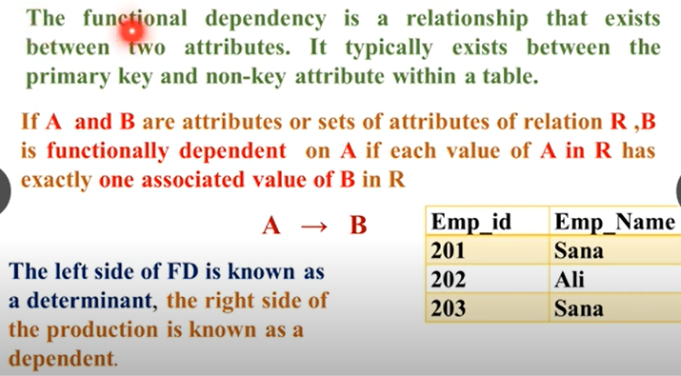
Functional dependency

Slide 17
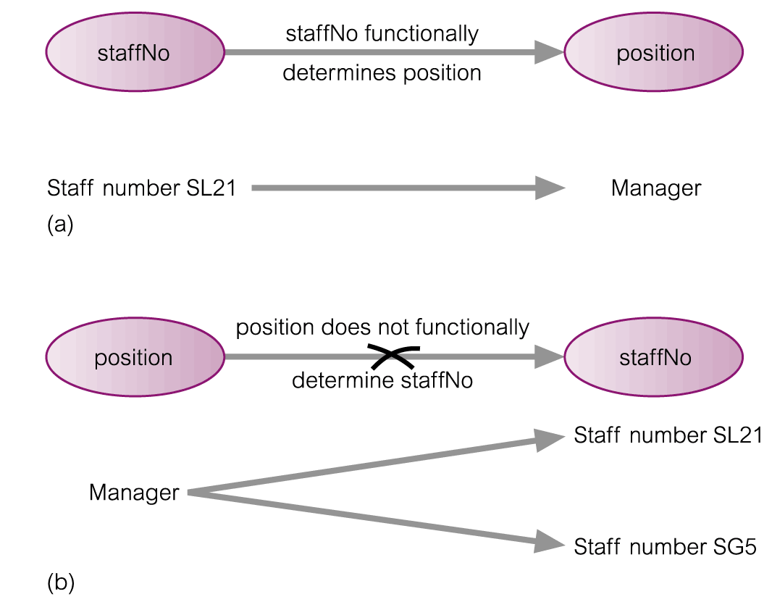
An Example Functional Dependency

Slide 18
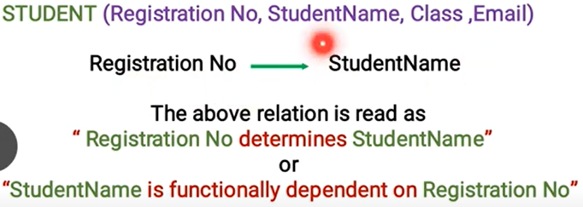
Functional dependency

Slide 19
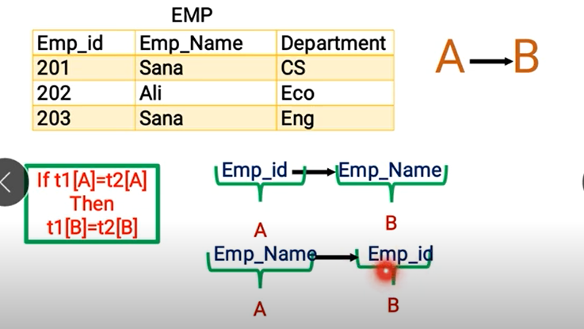
FD-Example

Slide 20


Types of FD

Slide 21
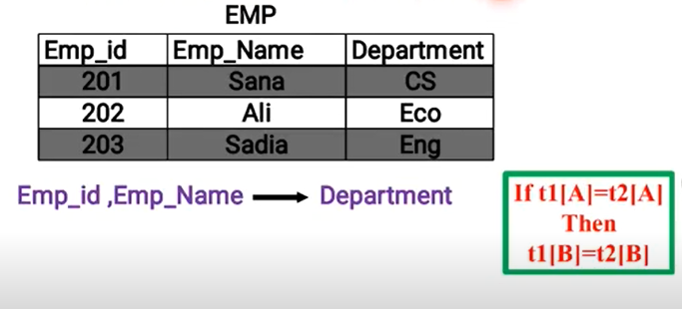

Fully FD

Slide 22
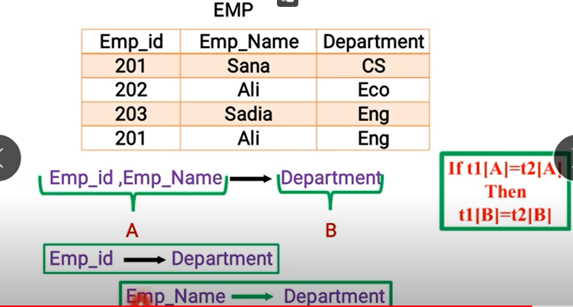
Is fully dependent /not ??

Slide 23
Partial FD
A FD x y is a partial dependency if some attribute A in x can be removed from x and dependency still hold .
  (Name , ID ) course

Slide 24
FFD example :
Student relation :
Name
Roll no
Grades
Games
Fees

Slide 25
FFD /PFD
Y is functionally dependent on x and
Y is not functionally dependent on any subset of x .
Y is functionally dependent on x and
Y can be determined by any subset of x

Slide 26
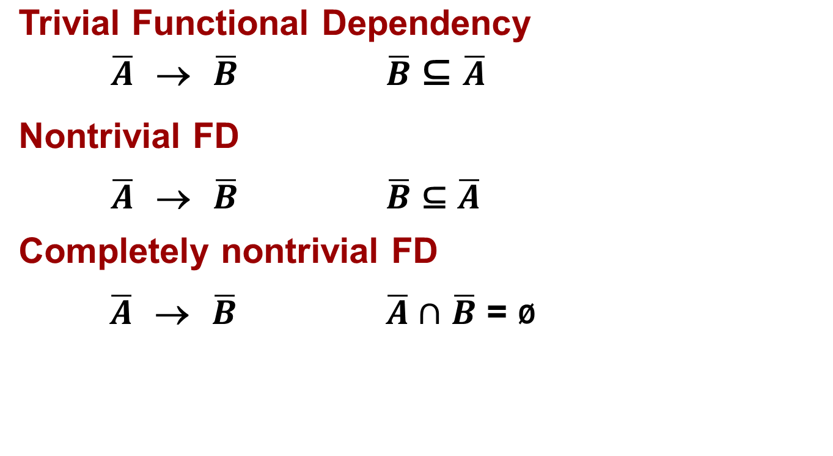
Functional Dependencies
Notes:
So here are a few other definitions related to functional dependencies. We have a notion of a trivial functional dependency. A functional dependency 𝑨 ̅ → 𝑩 ̅ is trivial if 𝑩 ̅ is a subset of 𝑨 ̅. In student relation, the HSname, HScity → HSname is a trivial functional dependency. Well, it's pretty obvious that if two tuples have the same values across their entire expanse for HSname, HScity , then obviously they're also going to have the same values for just this portion here, the HSname portion. So that's why it's called the trivial functional dependency.
A nontrivial functional dependency is a functional dependency that's not a trivial one. By the way, FD is a common abbreviation for functional dependency. So if we have 𝑨 ̅ → 𝑩 ̅, then that is non-trivial if it's not the case that 𝑩 ̅ is a subset of 𝑨 ̅. In student relation, HSname, HScity → HSname , HScode is a non trivial FD. And now we're saying there are some attributes in 𝑩 ̅ that are not part of 𝑨 ̅.
And the last definition is a completely nontrivial functional dependency, and that's 𝑨 ̅ → 𝑩 ̅ where 𝑨 ̅ and 𝑩 ̅ have no intersection at all. In student relation, HSname, HScity → HScode is a completely non trivial FD. And the reality is that completely nontrivial functional dependencies are the ones that we're most interested in specifying.

Slide 27

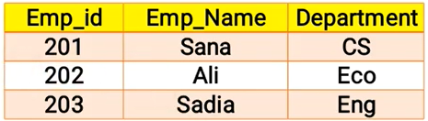
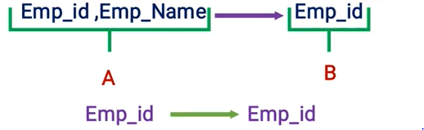
Trivial Functional dependency

Slide 28
Trivial and Non -trivial FD
A B & B A
  A A
  B B
AB B
  A A
  B B
A B & B A
  A C
  A B D

Slide 29

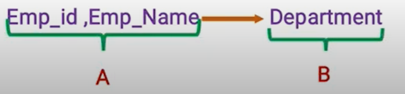
Non-trivial FD

Slide 30
Transitive and non- Transitive FDS
Transitive : X Y and Y Z then X Z
  Ssid sname and sname city
  sid city
  Roll no Semester
  Semester Hostel
Roll no Hostel (TFD)
Roll no Name (NTF)
Roll no Semester(NTF)
It is due to the dependency between non -PK in relation .
Name
X
Roll no
Semester Y
Hostel
Z

Slide 31
Properties of FD
Reflexive X Y XՈY≠ᵠ
Augmentation: if X Y , then XZ YZ
Ssid Sname
Ssid ,phone no Sname ,Phone no

Slide 32
Properties of FD
Union : If X Y and X Z then X YZ
Decomposition :
  X YZ
  Then X Y and X Z

Slide 33
Closure method (Example 1 )
This method will help out to find all possible candidate keys from the table .
R(A,B,C,D)
  FD{A B , B C , C D }
    A⁺ =BCDA
    B⁺ =BCD
    C⁺= CD
    D⁺= D
Primary attribute : which are used in formation of CK
Ck = {A}
PA = A
Non PA = BCD

Slide 34
Closure method (Example 2 )
R(A,B,C,D)
  FD{A B , B C ,C D , D A}
    A⁺ =ABCD
    B⁺ =BCDA
    C⁺= CDAB
    D⁺= DABC
CK ={A,B ,C ,D }
PA =(A,B ,C ,D )
NON PA = ᶲ

Slide 35
Closure method (Example 3 )
R(A,B,C,D,E)
  FD{A B , BC D ,E C , D A}
  AE⁺ = AEBCD
  DE⁺ =BEABC
  BE⁺ =BECDA
  CE⁺ =CE
CK= { AE,BE,DE}
PA = { A,B,D,E}
NPA =C

Slide 36
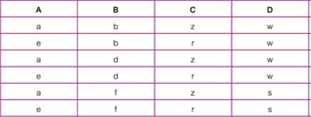
Example - Using sample data to identify functional dependencies. and ck . Also find PA and NPA

Slide 37
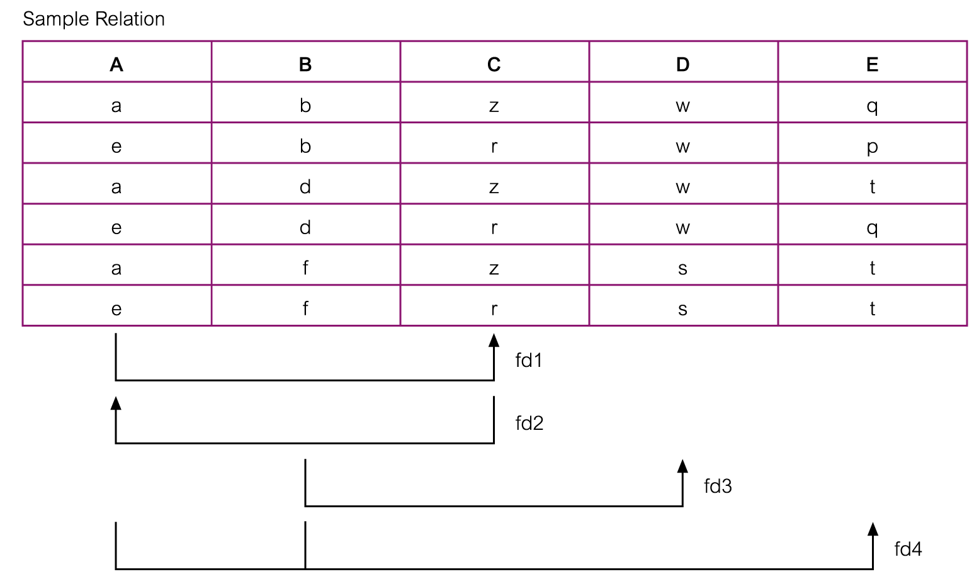
Example - Using sample data to identify functional dependencies.

Slide 38
Example - Using sample data to identify functional dependencies.
Function dependencies between attributes A to E in the Sample relation.
A → C (fd1)
C → A (fd2)
B → D (fd3)
A, B → E (fd4)

Slide 39
Normalization ---Decomposition
Two important properties of decomposition.
  Lossless-join property enables us to find any instance of the original relation from corresponding instances in the smaller relations.
  Dependency preservation property enables us to enforce a constraint on the original relation by enforcing some constraint on each of the smaller relations.

Slide 40


